Slide 1
Network Intrusion detection system
MACHINE LEARNING PROJECT
NAME : Veera Rakesh

Slide 2

An intrusion detection system (IDS) is a system that monitors network traffic for suspicious activity and alerts when such activity is discovered.

Slide 3
ABSTRACT
Computer networks are exposed to cyber related attacks due to the common usage of internet, as the result of such, several intrusion detection systems (IDSs) were proposed by several researchers. Among key research issues in securing network is detecting intrusions. It helps to recognize unauthorized usage and attacks as a measure to ensure the secure the network’s security. Various approaches have been proposed to determine the most effective features and hence enhance the efficiency of intrusion detection systems, the methods include, machine learning-based (ML).
The increasing occurrence of network attacks is a devastating problem for network services. Various research works are already conducted to find an effective and efficient solution to prevent intrusion in the network in order to ensure network security and privacy. Machine learning is an effective analysis tool to detect any anomalous events occurred in the network traffic flow.

Slide 4


Slide 5
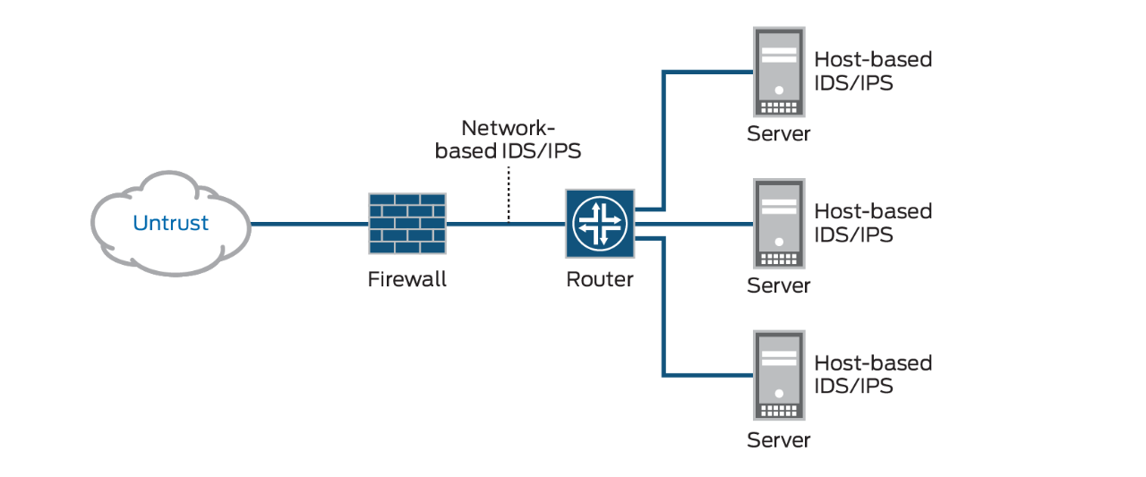

Slide 6


Slide 7
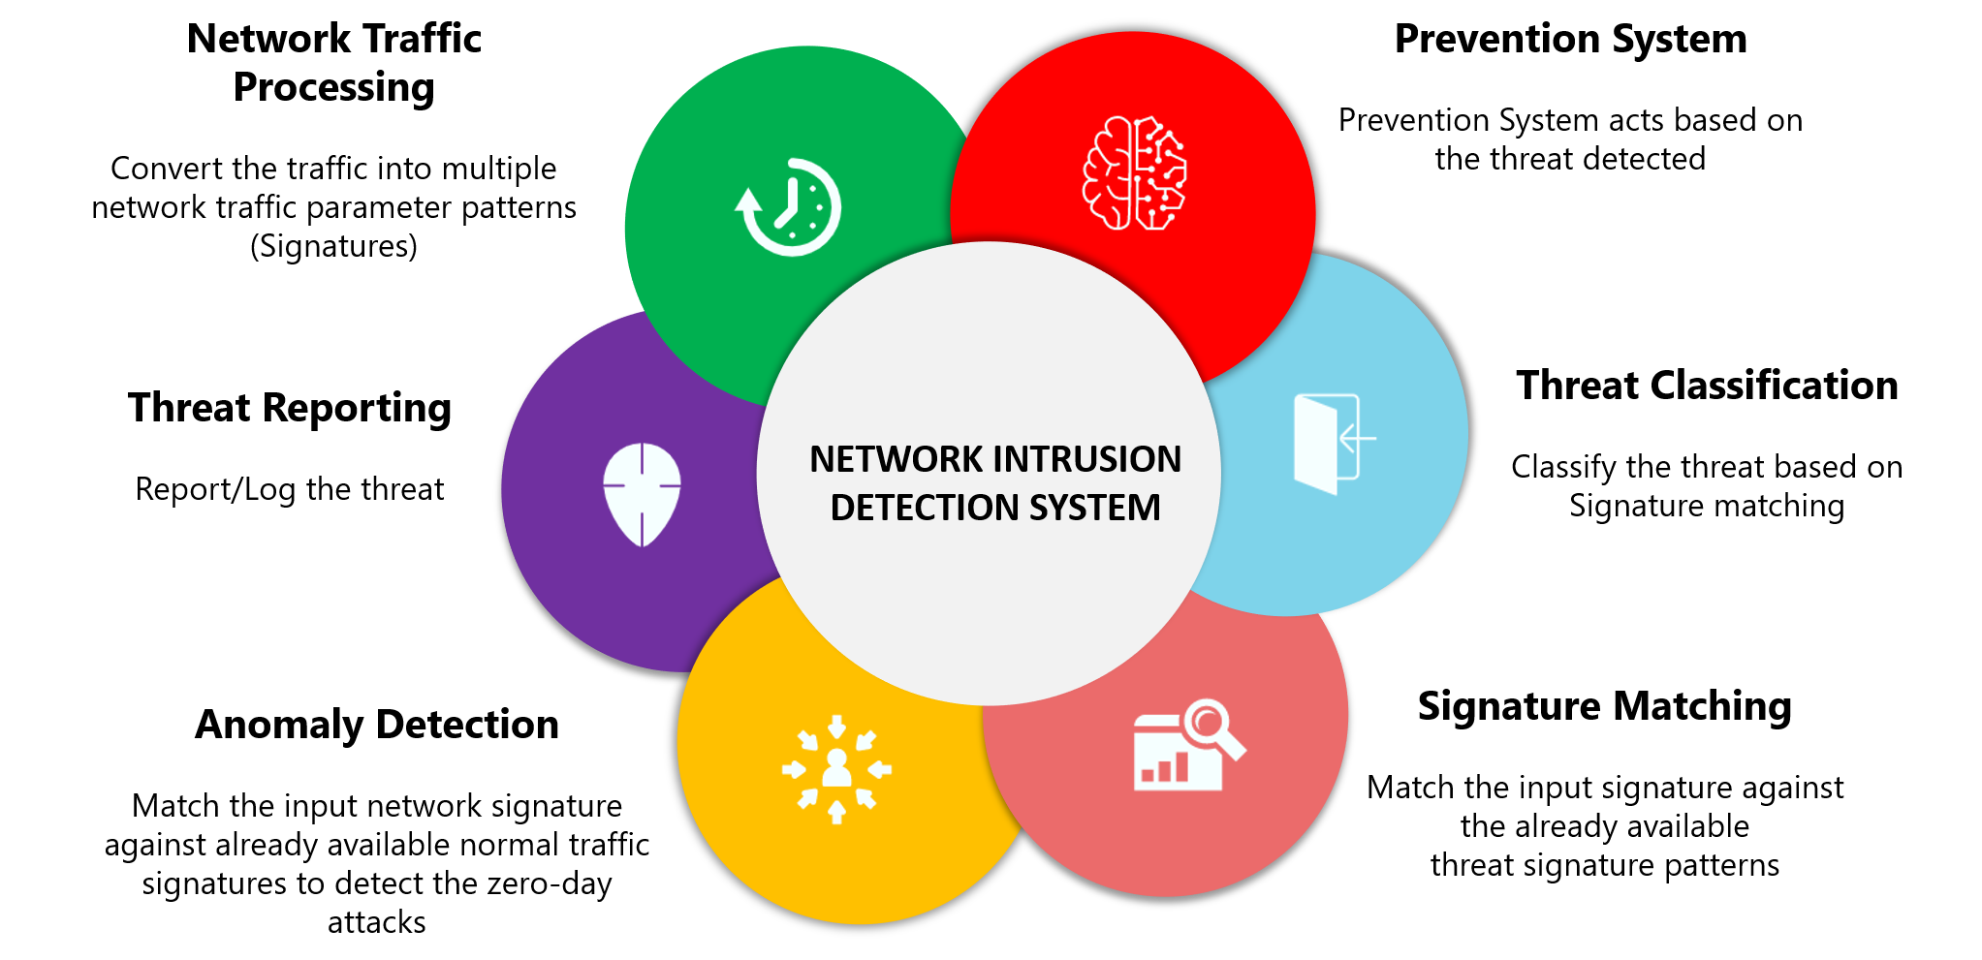

Slide 8
Problem ?
Understanding Intrusion Detection:
Another security measure you must consider is monitoring for intrusion. As hackers become more prevalent and savvy, you need additional tools to help protect your network environment. Intrusion detection is a strategy that any organization must consider.
Intrusion detection can be defined as the ability to monitor and react to computer misuse. Many hardware and software products on the market today provide various levels of intrusion detection.

Slide 9
ABSTRACT ?
LET SEE ->

Slide 10
Abstract :
The rapid advances in the internet and communication fields have resulted in a huge increase in the network size and the corresponding data. As a result, many novel attacks are being generated and have posed challenges for network security to accurately detect intrusions. Furthermore, the presence of the intruders with the aim to launch various attacks within the network cannot be ignored. An intrusion detection system (IDS) is one such tool that prevents the network from possible intrusions by inspecting the network traffic, to ensure its confidentiality, integrity, and availability. Despite enormous efforts by the researchers, IDS still faces challenges in improving detection accuracy while reducing false alarm rates and in detecting novel intrusions. Recently, machine learning (ML) IDS systems are being deployed as potential solutions to detect intrusions across the network in an efficient manner.
In recent decades, rapid development in the world of technology and networks has been achieved, also there is a spread of Internet services in all fields over the world. Piracy numbers have increased, also a lot of modern systems were penetrated, so the developing information security technologies to detect the new attack become an important requirement. One of the most important information security technologies is an Intrusion Detection System (IDS) that uses machine learning

Slide 11
Network intrusion detection system using classification
Security of network traffic is becoming a major problem of computer network system. As time is passing the number of attacks on the network are increasing. Such attacks on network are nothing but the Intrusions. Intrusion detection system has been used for detecting intrusion and to protect the data and network from attacks. Data mining techniques are used to monitor and analyze large amount of network data & classify these network data into anomalous and normal data. Since data comes from various sources, network traffic is large. Data mining techniques such as classification and clustering are applied to build Intrusion detection system. This paper presents the classification of IDS, different Data mining techniques and datasets for the effective detection of pattern for both malicious and normal activities in network, which helps to develop secure information system. Also it provides a brief study of various datasets that are useful for an intrusion detection system.

Slide 12
Data Pre-processing, Cleaning & Transformation
Before building the model, it is important that we pre-process, clean and transform the data to a usable one such that we avoid any kind of redundancies, noise, missing data etc. that might actually disrupt us from building a good model. The following were done by us: -
String to categorical variables - Converting features/columns with strings to categorial variables/numerical values – We mapped 3 features namely, protocol type, service and flag to numbers so that we could build a model accordingly.
This is an important step. We also mapped the output variable/feature, class to 0 and 1 where 1 represents an anomaly and 0 represents normal behaviour.

Slide 13
Remove duplicate rows – Another important step to be performed is the removal of duplicate rows since duplicate data might mess up the model that we are going to build. So, we remove any duplicate rows present in the dataset.
Remove missing data – When you are provided with a dataset, you might have missing or null values present in certain columns or rows. There are a few ways to deal with it based on the type of data.
If the number of missing or NaN values present in the dataset is considerably small compared to the size of the whole dataset, it wouldn’t hurt to remove such data. Hence, we remove the rows where any of the column value is missing/NaN.

Slide 14
Modeling
The final step is to build our model as the data is full prepared and ready. We’ll one again leverage scikit-learn to split our data into train and test sets. We split our data into train and test in a 4:1 ratio i.e. 67% train data and 33% test data. We could opt 80-20 or 50-50 splits as well (train-test) Post that, we use the Decision Tree Classifier with entropy as our criterion and a max depth of 4. And then we train the model with our training just taking less than 1 second. Post-training, we do the prediction with the test data and that also takes less than a second. We can observe that the train and test accuracies are 91.27% and 90.66% respectively, which is pretty good. To see if the accuracy can be improved, we try to train and test using the XG Boost algorithm as well leveraging the XGBClassifier. After train and test, we can observe that the accuracy improved by quite a good margin. Training accuracy jumped to 98.72% and the test accuracy was 98.51%. The XG boost algorithm basically makes use of gradient boosting decision tree algorithm.

Slide 15


Slide 16
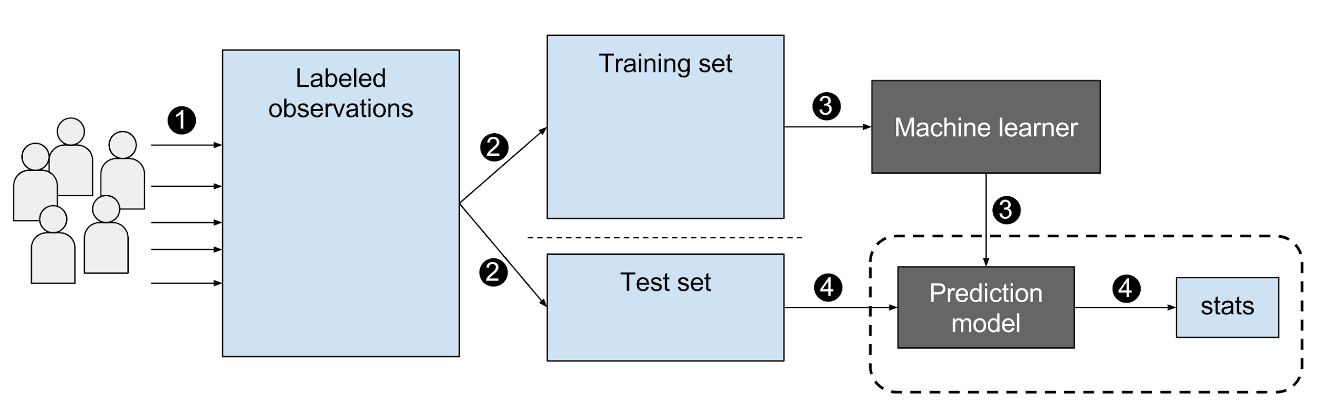
Apply?

Slide 17
Related work
Agrawal and Agrawal [1] surveyed various data mining techniques for intrusion detection. Various machine learning techniques, individually or in hybrid form have been widely used not only in the field of clustering or classification but also for reducing the dimensionality and feature selection of IDS.
Gendreau and Moorman [2] represented a survey of Intrusion Detection Systems towards an End to End Secure Internet of Things (IoT) and this survey of the IDS use the most recent ideas and methods to propose the present IoT. To understand and illustrate IDS platform differences and the current research trend towards a universal, cross-platform distributed approach has been taken into consideration.

Slide 18
Conti.
Another popular survey by Kabiri and Ghorbani [3] presented trends in IDS and also analyzed some problems regarding intrusion detection. Traditional IDS faces challenges like, time consumption, log-file updating, statistical and rule-based analysis, and accuracy.

Slide 19
Research References
[1] S. Agrawal and J. Agrawal, "Survey on anomaly detection using data mining techniques", Proc. Comput. Sci., vol. 60, no. 1, pp. 708-713, 2015.
[2] A. A. Gendreau and M. Moorman, "Survey of intrusion detection systems towards an end to end secure Internet of Things", Proc. IEEE 4th Int. Conf. Future Internet Things Cloud (FiCloud), pp. 84-90, Aug. 2016.
[3] P. Kabiri and A. A. Ghorbani, "Research on intrusion detection and response: A survey", Int. J. Netw. Secur., vol. 1, no. 2, pp. 84-102, 2005.

Slide 20



